Slide 1
MRA TAXPAYER SOLUTION
PROTOTYPE OF SCREEN DESIGNS AND MENUS
BY
YANKHO CHITUNGU

Slide 2
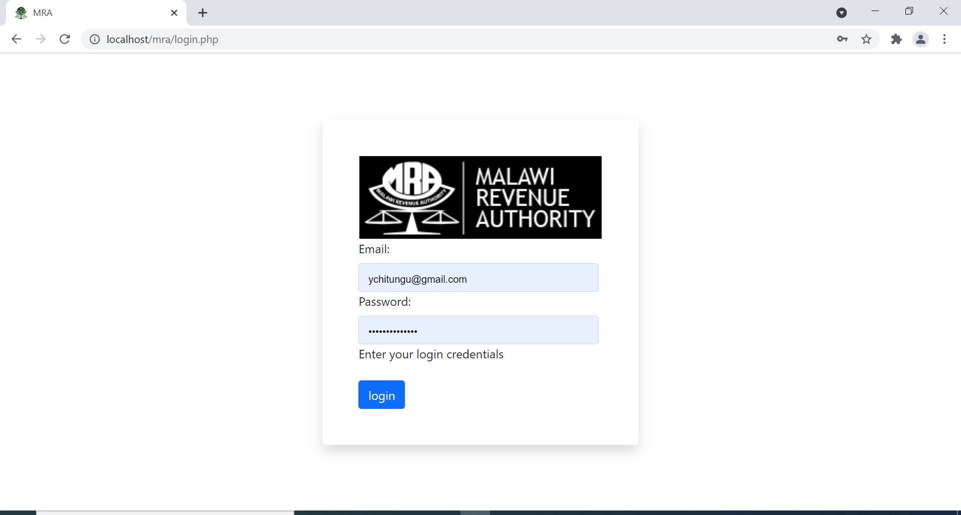
LOGIN PAGE

Slide 3
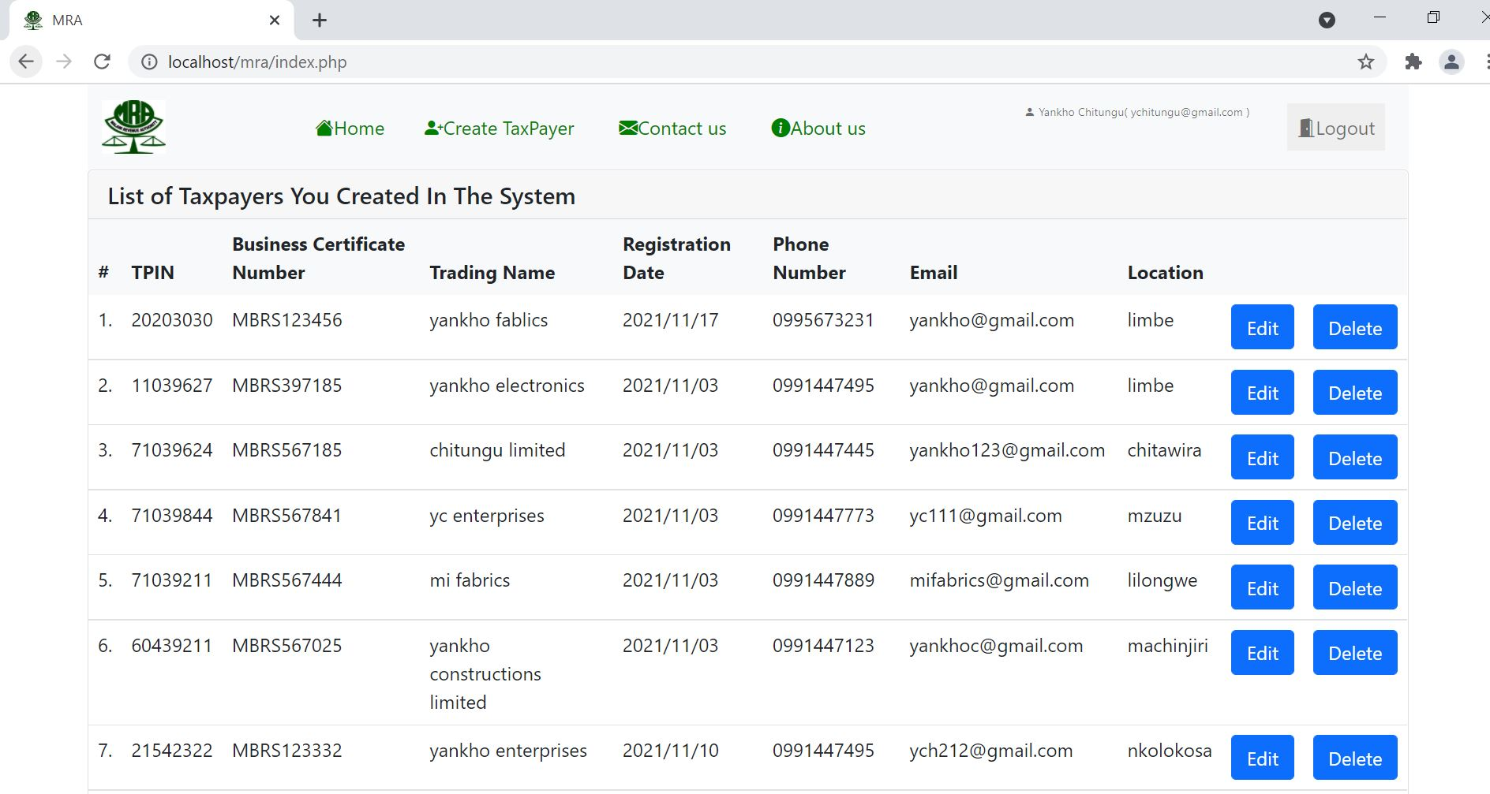
HOME PAGE

Slide 4
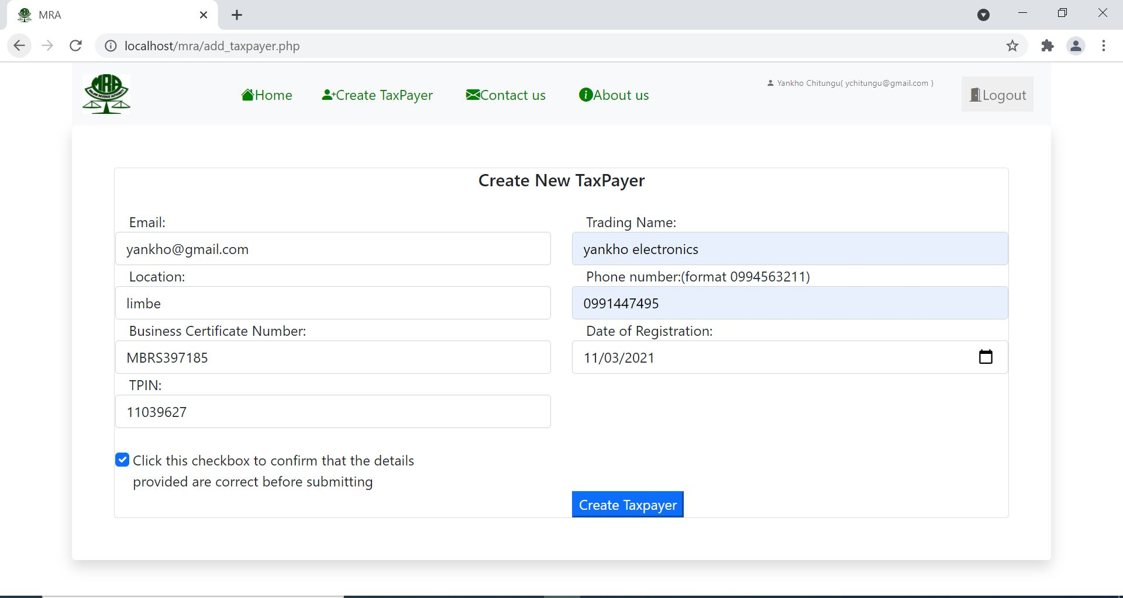
CREATE TAXPAYER PAGE

Slide 5
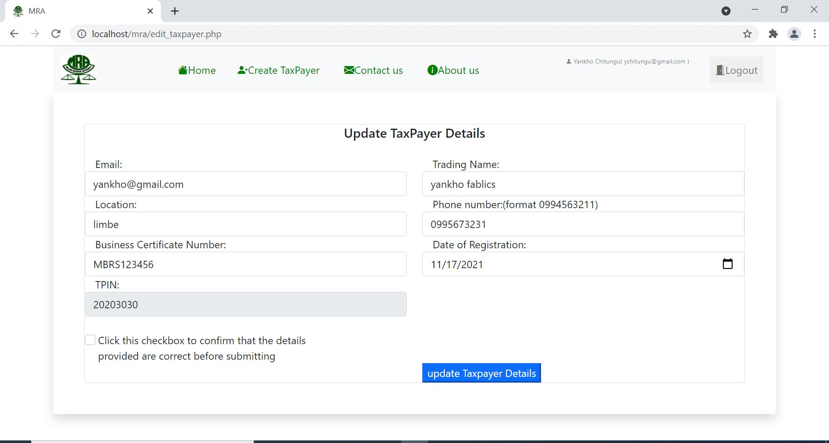
EDIT TAXPAYER PAGE

Slide 6
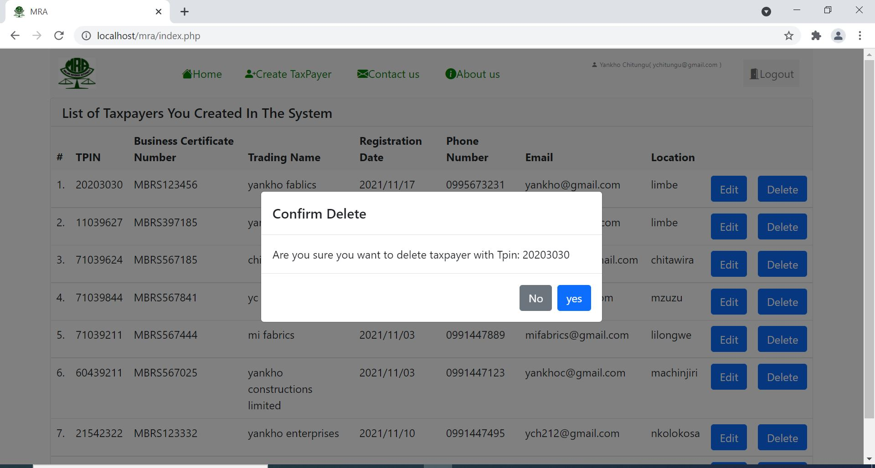
DELETE PAGE

Slide 7
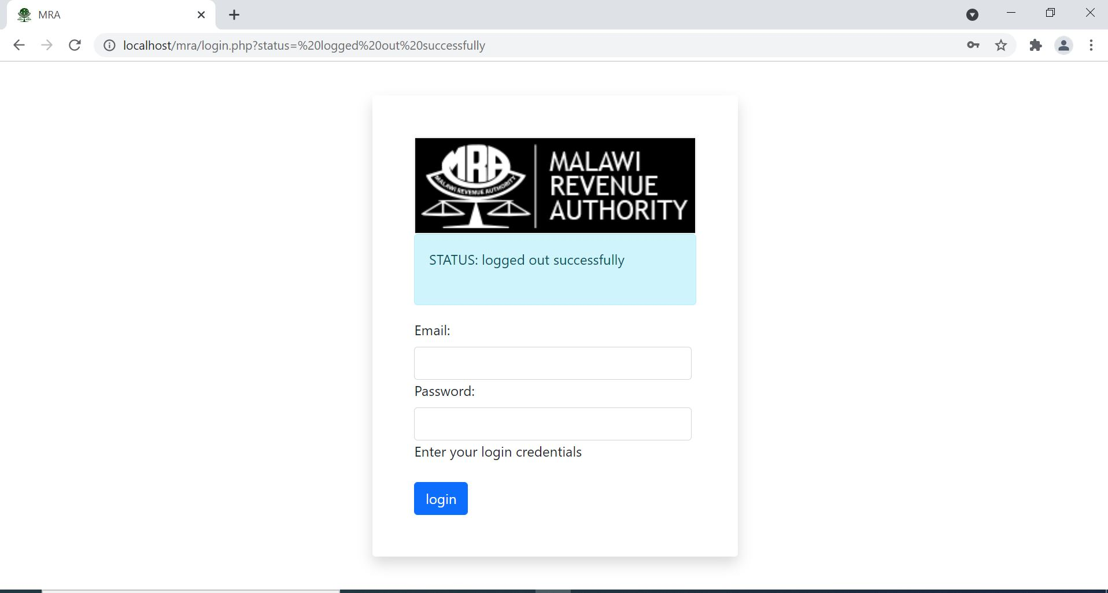
LOGOUT

Slide 8
THE END

